Slide 1
Rockbuster Stealth: 2020 Company Strategy
Home
Pamela Nouboussi

Slide 2
TABLE OF CONTENTS
01
Introduction
02
REVENUE
03
CUSTOMERS
04
CONCLUSION
01
02
Goals and objectives
Summary statistics
You can describe the topic of the section here
03
04
You can describe the topic of the section here
Summary and future recommendations

Slide 3
01
Introduction
Home
01

Slide 4
Goals and Objectives
Home
Due to rising competition from online streaming services such as Netflix and amazon,
the Rockbuster Stealth management team plans to use it’s existing movie licenses to launch an online video rental service.

Slide 5
The current situation…
Films
Customers
Home
1000 films in our collection
20 genres
All from the year 2006
Average movie length 115 min
Most movies are rated PG-13
584 active (97.4%)
In 109 countries

Slide 6
The numbers
Home
Average replacement cost:2.98
Replacement rate :
Min 9.9,
Max 29.9
Average 19.98
Total revenue: 61,312
Average rental cost: 2.98
Rental duration :
min 3 days
max 7 days
average 4.98 days

Slide 7
REVENUE
Home
02

Slide 8
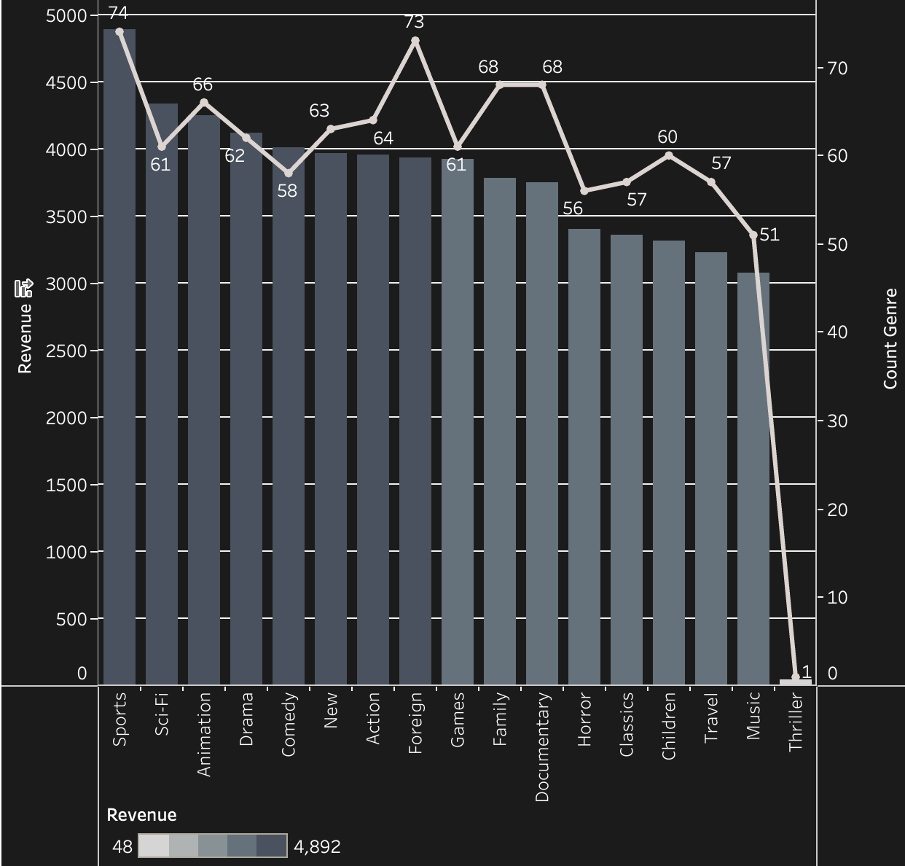
Film Categories
Home
The most profitable categories are Sports, Sci-Fi and Animation
The least are Thriller, Music and Travel
Foreign movies have the 2nd highest count of films but the 9th in revenue

Slide 9
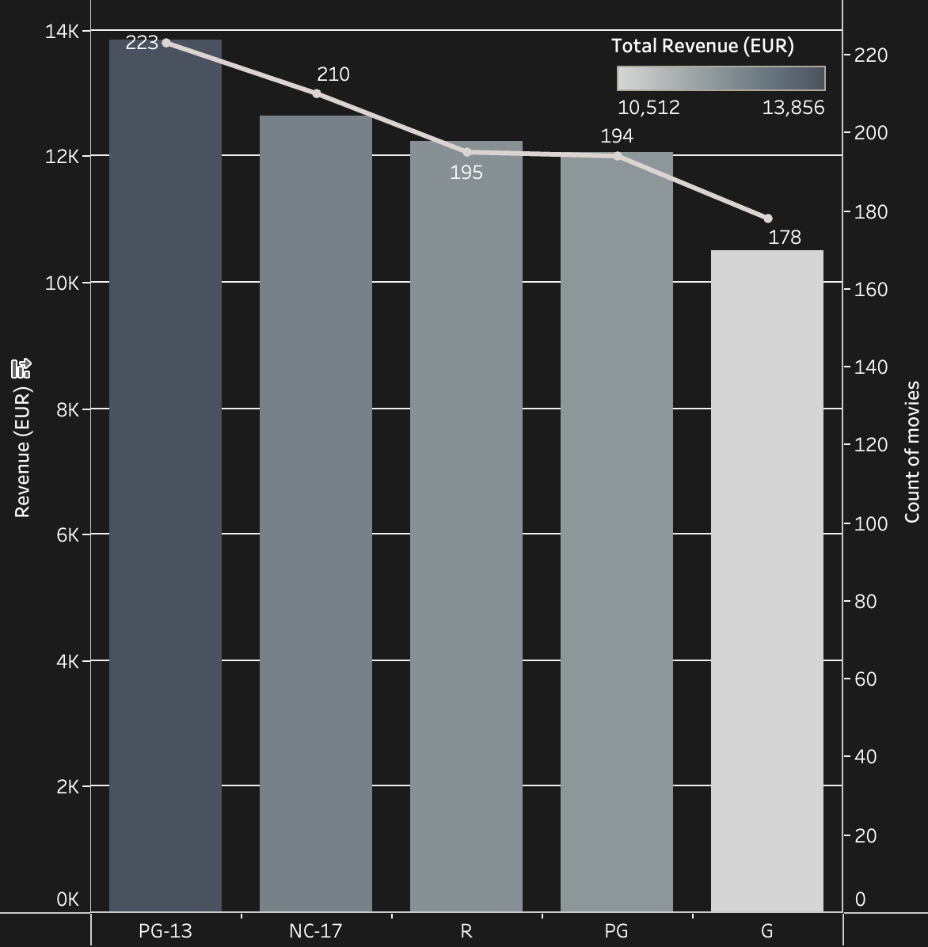
Ratings
Home
PG-13 films have the highest revenue, and the highest number of films
G movies are the least profitable

Slide 10
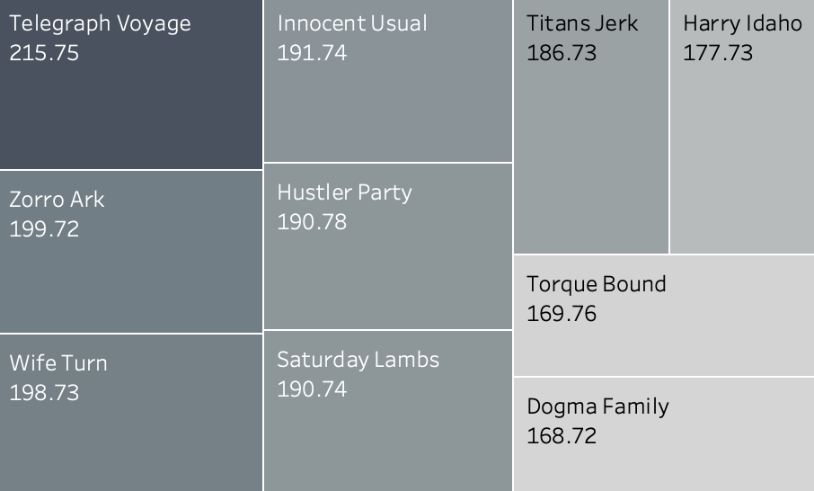
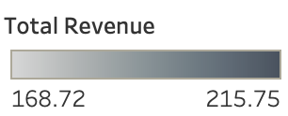
Highest Earning films
Telegraph Voyage
Zorro Ark
Wife Turn
Home
215 € total revenue
Music film
199 €
Comedy
198€
Documentary

Slide 11
OUR CUSTOMERS
Home
03

Slide 12
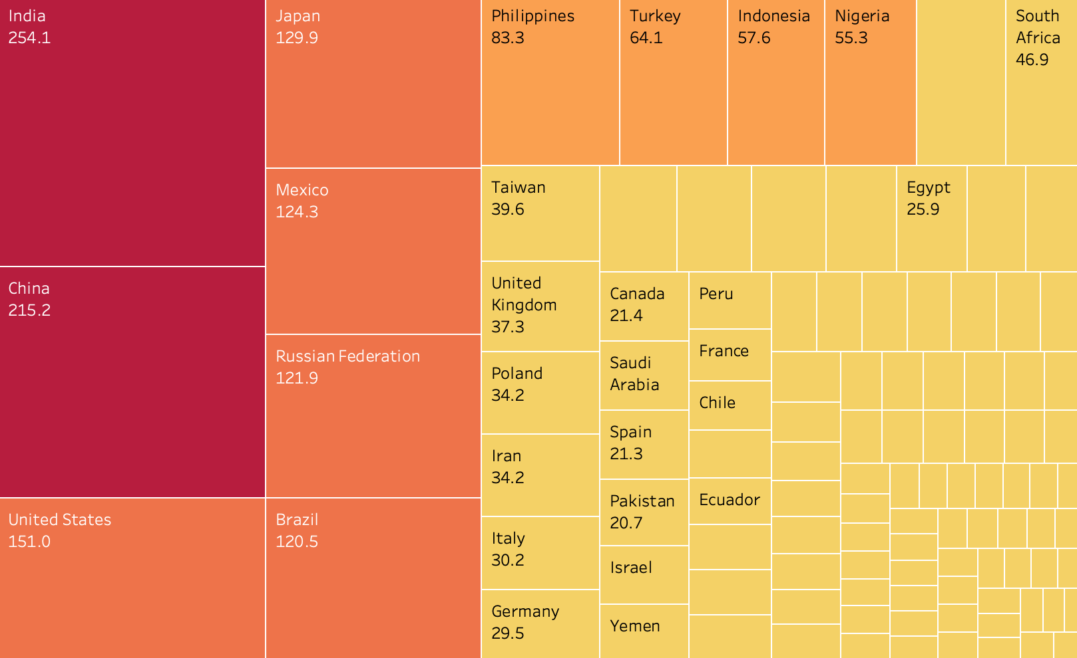

Country Revenue
Home
The average spent by customers in each country.
Customers on average spent more in the highest revenue countries

Slide 13
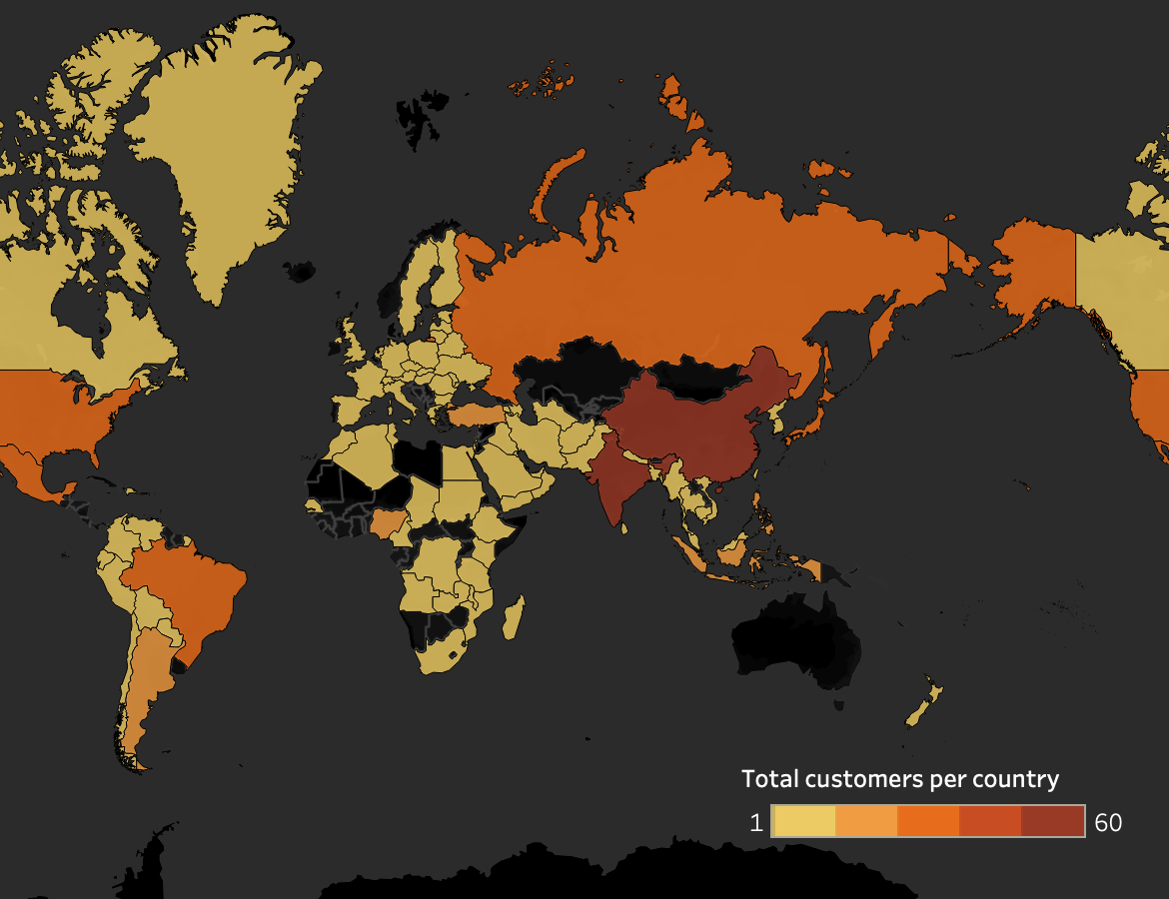
Customer Location
Home
Top 5 customers per country
 | Customers | Revenue Total
India | 60 | 6034.78
China | 53 | 5251.03
United States | 36 | 3685.31
Japan | 31 | 3122.51
Mexico | 30 | 2984.82
Asia, Europe then North America are the regions with the highest revenue
Africa and Oceania have the lowest revenue

Slide 14
Conclusion
Home
About me
What I do
My experience
My work
04

Slide 15
Launch Recomendations- Global market
Focus on top revenue regions
Films
Genre
Ratings
Home
01
03
Stock more films, 1000 is small for a global market
Offer films in more languages
Asia and the Americas have the top highest grossing countries
02
04
Add more films for top performing genres
Add more films to the
PG and G movies are the most profitable

Slide 16
Launch Recomendations- Films
Update inventory
Home
Asia, Europe and the Americas are the highest grossing regions
3 of the highest grossing countries are in Asia and 2 in the Americas. These regions should be prioritized for customer retention and acquisition. Focus on these to % countries
Create a loyalty program to reward customers.

Slide 17
Launch Recomendations- Competitors
Home
Create monthly/yearly subscription plan. The average rental cost is € 2.98 . That could be a good starting price point.
Start offering TV shows to attract a wider audience and keep up with competitors

Slide 18
CREDITS
Home
Template created by SlidesGo
Tableau Visualisation: https://public.tableau.com/app/profile/pamela.nouboussi/viz/Task3_10_16847836968880/Story3?publish=yes
THANK YOU!

